Slide 1
Other Consensus Protocols

Slide 2
PoW Disadvantages
If one mining pool controls more than 51 percent of the total mining power, the entire blockchain security is at risk as you have one central collective (Like one central computer/server).
A DDOS attack against the network can put the entire trustworthiness of the network at risk.
Notes:
Source: The Blockchain Developer, by Elad Elrom.

Slide 3
On PoW, as the difficulty goes up, that means less profit.
Less profit results in less incentive to mine coins.
Ethereum cryptocurrency is facing a problem of reduced miners in the network, and in 2018 Ethereum had to plan a “difficulty bomb,” which reduced the difficulty (raising profit for miners), as well as switch from PoW to PoS (Proof of stake) to increase scalability.

Slide 4
Many view PoW as unsustainable and insufficient because of the amount of electricity a miner uses and the slow transaction speed compared to other algorithms.

Slide 5
A pool that accounts for 51 percent of the network’s hashing power is able to create its own block and post it faster than the main blockchain updates.
The block holds 51 percent of the network and is able to double spend coins by removing transactions after spending so that the coins are not taken from the originating wallet.
Notes:
Source: The Blockchain Developer, by Elad Elrom.

Slide 6
51 percent of the network’s hashing power!?
Bitcoin uses a PoW system and as such is susceptible to a potential Tragedy of Commons.
The Tragedy of Commons refers to a future point in time when there will be fewer bitcoin miners available due to little to no block reward from mining.
The only fees that will be earned will come from transaction fees which will also diminish over time as users opt to pay lower fees for their transactions.
With fewer miners than required mining for coins, the network becomes more vulnerable to a 51% attack. A 51% attack is when a miner or mining pool controls 51% of the computational power of the network and creates fraudulent blocks of transactions for himself while invalidating the transactions of others in the network.
Notes:
source: https://www.investopedia.com/

Slide 7
Proof of Stake (PoS)
PoS was created by Sunny King and Scott Nadal in 2012 as an alternative to solve the PoW cons mentioned earlier.
PoS relies on how many coins a peer holds. The peer needs to stake the number of coins it wants to mine.
Instead of hashing power, we have stake power, and there is no dependency on energy consumption because there is no puzzle to solve.
PoS provides a similar hashing block scheme to bitcoin’s PoW, but it limits the number of peers. This provides the needed security yet lowers the cost and power consumption.
Notes:
Source: The Blockchain Developer, by Elad Elrom.

Slide 8
A network fee is provided to peers instead of giving a reward for solving a mathematical puzzle as in PoW.
PoS determines what peer does the work by the size of the stake the peer holds. This achieves a distributed consensus at less energy and less cost.
DDOS attacks and frauds are still possible. However, attackers cannot transact more digital currency than they are staking and they would lose their deposits, so the chances are lower for an attack.
Notes:
Source: The Blockchain Developer, by Elad Elrom.

Slide 9
With a PoS, the attacker would need to obtain 51% of the cryptocurrency to carry out a 51% attack.
The proof of stake avoids this ‘tragedy’ by making it disadvantageous for a miner with a 51% stake in a cryptocurrency to attack the network.
Although it would be difficult and expensive to accumulate 51% of a reputable digital coin, a miner with 51% stake in the coin would not have it in his best interest to attack a network which he holds a majority share.
Notes:
source: https://www.investopedia.com/

Slide 10
If the value of the cryptocurrency falls, this means that the value of his holdings would also fall, and so the majority stake owner would be more incentivized to maintain a secure network.
In addition to Bitcoin, Litecoin (LTC) also uses the PoW method.
(NXT) is an example of a cryptocoin that uses the PoS method.
Some coins like Peercoin (PPC) use a mixed system where both methods are incorporated.
Currently, Ethereum (ETH) is in the process of switching to a PoS system.
Notes:
source: https://www.investopedia.com/

Slide 11
Mining under PoS
Any peer can participate in the mining process by staking coins in order to validate a new transaction.
To become a miner, there are two options;
You can stake your coins to be used by a trustworthy node (but you can lose your coin via a fraud of the PoS network by the node).
You can submit a full node to be selected as a miner.
Each miner gets selected randomly; it’s not based on solving a puzzle.
Notes:
Source: The Blockchain Developer, by Elad Elrom.

Slide 12
Comparison, PoW vs PoS
Category | PoW | PoS
Generating new blocks | First miner to solve problem selected based on hashing power | Random selection based on stake power (how many coins a peer holds)
Reward | Block reward | Network fees
Energy and resource consumption | ASIC miner and large footprint | Little resource and low energy consumption
Notes:
Source: The Blockchain Developer, by Elad Elrom.

Slide 13
Delegated Proof of Stake (DPoS)
Delegated proof of stake is a census algorithm method invented by Dan Larimer discussed in the white paper.
DPoS is aimed to improve PoS cons by providing a democracy instead of the random process of selecting a miner.
In DPoS, the miners are called block producers.
Notes:
Source: The Blockchain Developer, by Elad Elrom.

Slide 14
DPoS achieves a technological democracy by splitting the process of mining into two parts:
Election: When electing a group of block producers, there are only 21 block producers instead of unlimited as with PoW.
Scheduling production: Each one of the 21 block producers takes turns to produce a block every 3 seconds.
The election process provides a technological democracy and ensures stakeholders are in control because large stakeholders have the most to lose if a network fails.
Notes:
Source: The Blockchain Developer, by Elad Elrom.

Slide 15
Each block producer takes a turn at producing a block, and the longest possible chain gets adopted (just like in PoW).
Each peer, 1 through 3 gets its turn to produce the longest chain block.
Anytime an honest peer node sees a valid strictly longer chain, it will switch from its current chain (copy) to the longer one.
Notes:
Source: The Blockchain Developer, by Elad Elrom.

Slide 16
DPoS is able to continue and function even when most of the producers fail.
The Figure below shows a minority fork, where peer 2 only gets to post the longest chain once during a cycle.
During a fail process, the community can vote and replace a failed peer producer, in this case peer 1, or peer producers until the network resumes to normal operation.
Notes:
Source: The Blockchain Developer, by Elad Elrom.

Slide 17
DPoS uses the power of stakeholders to approve voting of the consensus algorithm rules such as incentive fees, block intervals, forks, and transaction sizes.
The elected delegates can reach to a consensus to decrease the transaction time significantly (1 second versus 10 minutes for PoW).
Examples of popular DPOS blockchains are Bitshares, Steem, and EOS.
Notes:
Source: The Blockchain Developer, by Elad Elrom.

Slide 18
What is Bitcoin
“Bitcoin is a cryptocurrency, a form of electronic cash. It is a decentralized digital currency without a central bank or single administrator that can be sent from user-to-user on the peer-to-peer bitcoin network without the need for intermediaries. Transactions are verified by a network of nodes through cryptography and recorded in a public distributed ledger called a Blockchain.”

Slide 19
What is Bitcoin?
TECHNOLOGY
PROTOCOL
/ COIN /
TOKEN

Slide 20
What is Bitcoin?
TECHNOLOGY
PROTOCOL
/ COIN /
TOKEN

Slide 21
What is Bitcoin?
TECHNOLOGY
PROTOCOL
/ COIN /
TOKEN

Slide 22
What is Bitcoin?
TECHNOLOGY
Blockchain
PROTOCOL
/ COIN /
TOKEN

Slide 23
What is Bitcoin?
TECHNOLOGY
Blockchain
PROTOCOL
/ COIN /
Bitcoin
TOKEN

Slide 24
What is Bitcoin?
TECHNOLOGY
Blockchain
PROTOCOL
/ COIN /
Waves
Ethereum
Bitcoin
Neo
Ripple
TOKEN

Slide 25





What is Bitcoin?
TECHNOLOGY
Blockchain
PROTOCOL
/ COIN /
Waves
Ethereum
Bitcoin
Neo
Ripple
TOKEN

Slide 26
There are three important layers.
Layer one is technology, Then layer two is protocol, and layer three is token.
Layer 2 is the protocol where we have applications like Bitcoin and it's very important to understand that Bitcoin is not just a currency it's an actual protocol.
A protocol is a set of rules that guide how participants over a network communicate with each other.
For example TCP or IP or HTTP, those are all protocols because they allow participants in the networks to communicate with each other.
The IP is the internet protocol which allows us all to participate in the Internet.
HTTP is a hypertext transfer protocol. Is used to transfer data over the web, it is a part of the Internet protocol suite and defines commands and services used for transmitting webpage data.

Slide 27
Bitcoin is no different. It is a protocol of a set of rules on how participants of the bitcoin network will communicate with each other and agree on things.
For example the protocol dictates how they should come to consensus on things.
The protocol also dictates how public keys and signatures should be used for authentication.
The protocol also dictates on how they agree on updates to the protocol itself and many more other things.
There are other protocols such as Ethereum, Ripple, Neo, and Waves. Each protocol has its coin.
The world of cryptocurrencies rely on the same technology which is the blockchain technology.

Slide 28
What is Bitcoin?
TECHNOLOGY
Blockchain
PROTOCOL
/ COIN /
Waves
Ethereum
Bitcoin
Neo
Ripple
TOKEN
TRX
AE
REP
SNT
RHOC
MKR
PPT
BNB

Slide 29
There's only one coin attached to every protocol.
The coin is an innate asset of the protocol which facilitates the interaction of players which is used to reward people for mining the blockchain and adding blocks. It is also used for people to be able to purchase things from each other and so on.
Layer three is the token.
ICO (Initial Coin offer): It's a very misleading term because ICO is actually about tokens.
Tokens rely on smart contracts which are built on top of the different protocols we see in Layer 2.

Slide 30
Ethereum is the most popular protocol for creating smart contracts and for creating tokens, it has the highest number of tokens as hundreds of tokens.
Bitcoin has no tokens on it because it does not facilitate that concept of creating smart contracts and therefore nobody creates tokens on Bitcoins.
Ripple also doesn't have any tokens on it.
Neo on the other hand has quite a lot of tokens in it. Waves has a couple of tokens on it as well.
ICO’s refer to tokens not coins.

Slide 31
https://coinmarketcap.com
To explore things like the volume or the trading volume, the market capitalization of currency, the graphs, the prices and so on.
There's like hundreds and hundreds of Crypto currencies.

Slide 32
What is Bitcoin?
TECHNOLOGY
Blockchain
PROTOCOL
/ COIN /
Waves
Ethereum
Bitcoin
Neo
Ripple
TOKEN
TRX
AE
REP
SNT
RHOC
MKR
PPT
BNB

Slide 33
What is Bitcoin?
TECHNOLOGY
Blockchain
PROTOCOL
/ COIN /
Waves
Ethereum
Bitcoin
Neo
Ripple
TOKEN
WCT
BL
TRX
AE
ACAT
TNC
WGR
INTL
REP
SNT
DBC
RPX
RHOC
MKR
QLC
TKY
PPT
BNB
ONT
IAM

Slide 34
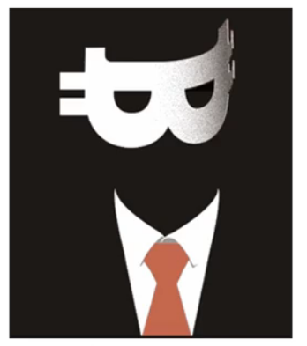
What is Bitcoin?
Satoshi Nakamoto is the name used by the unknown person or people who developed bitcoin
In October 2008, Nakamoto published a paper titled
"Bitcoin: A Peer-to-Peer Electronic Cash System"
In January 2009, the bitcoin network came into existence with Satoshi Nakamoto mining the genesis block of bitcoin (block number 0), which had a reward of 50 bitcoins.
PROTOCOL
/ COIN /
TOKEN
Satoshi Nakamoto

Slide 35

What is Bitcoin?
PROTOCOL
/ COIN /
Bitcoin is the first application project that successfully transferred the Blockchain technology from theory to a useful application.
TOKEN

Slide 36
Bitcoin is about taking that blockchain technology from theory and moving into practice so that a network of people can transact with each other using this technology.
The bitcoin users don't need intermediaries between them even though they never met before, they can still trust each other because they trust the technology behind it and this cancels the need for different intermediaries such as banks.

Slide 37


What is Bitcoin?
PROTOCOL
/ COIN /
TOKEN

Slide 38



What is Bitcoin?
The Bitcoin Ecosystem:
Nodes
Miners
Large mines
PROTOCOL
/ COIN /
Mining Pools
TOKEN

Slide 39
The Bitcoin ecosystem includes :
Nodes and it's not a term for people, it's a term for the devices that people use to transact with each other on this network, and usually these devices are not used for mining the network.
Miners are the participants who actually enable the blockchain to grow by adding transactions into blocks and adding blocks into the blockchain.
Large Miners are miners with huge computation power and a big number of devices and equipment, and they play a major role in the fast growth of the blockchain.
Mining pools, when miners gather their computation power and coordinate the mining process.

Slide 40
Bitcoin Monetary Policy
Monetary policy: the central banks of the governments have their own monetary policies which represents the financial system of these banks.
Bitcoin also has a monetary policy.
Bitcoins monetary policy consist of two main parts:

Slide 41
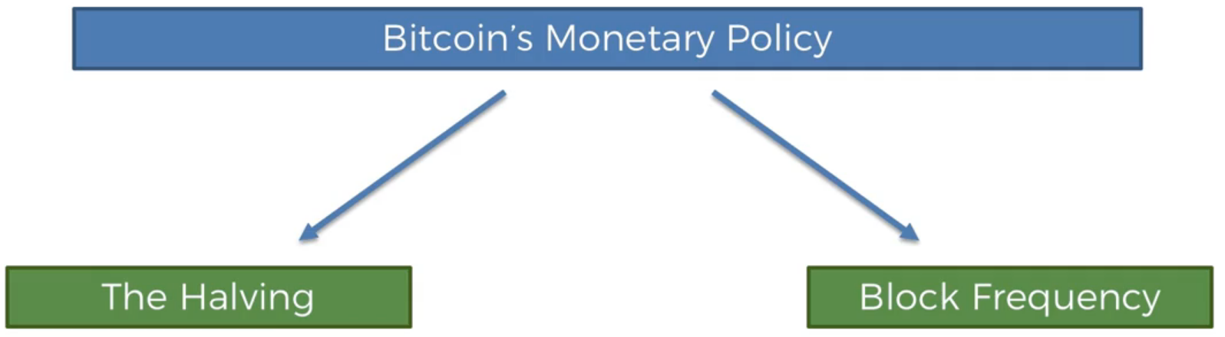
Bitcoin Monetary Policy

Slide 42
In bitcoin and other cryptocurrencies, mining requires computers to compete with each other to solve a complicated math problem. Once solved, a new block can be added to the chain of blocks and a reward of brand new bitcoin is given to the computer that solved the math problem first.
Halving is the reduction of the bitcoin mining reward by half.

Slide 43
This principle states that the number of bitcoins released into the system is halved every single four years.
Or every two hundred and ten thousand blocks.
So you can see here that every 210000 blocks the number of bitcoins per block is reduced by half.
At the start it was 50 BTC per block, then from 2012 it was reduced to 25 BTC per block.

Slide 44
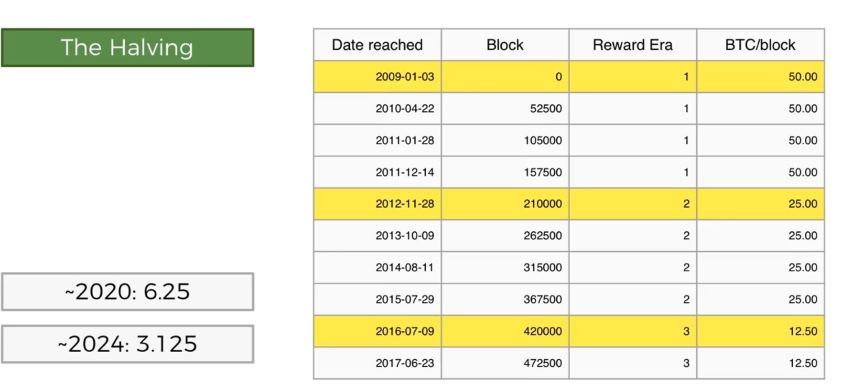
Bitcoin Monetary Policy

Slide 45
The monetary policy of BTC is entirely controlled by its software (the algorithm or the protocol that belongs to the bitcoins).
Its not a person who is going to change the number of bitcoins released this year to this amount.
It is considered as an effective policy which is able to keep things under control such as inflation control.
BTCs are released every single time there is a block created, the halving principle controls the quantity of released BTCs.

Slide 46
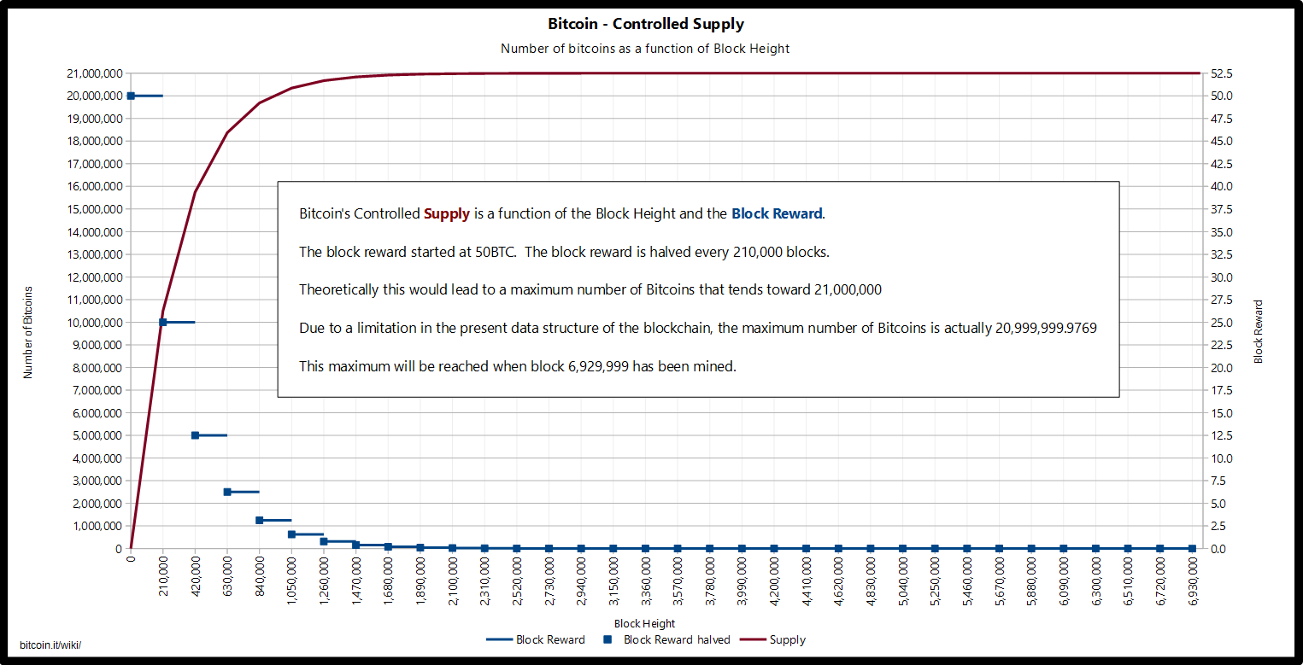
Bitcoin Monetary Policy

Slide 47
Bitcoin Monetary Policy
21 Million Bitcoins By 2140

Slide 48
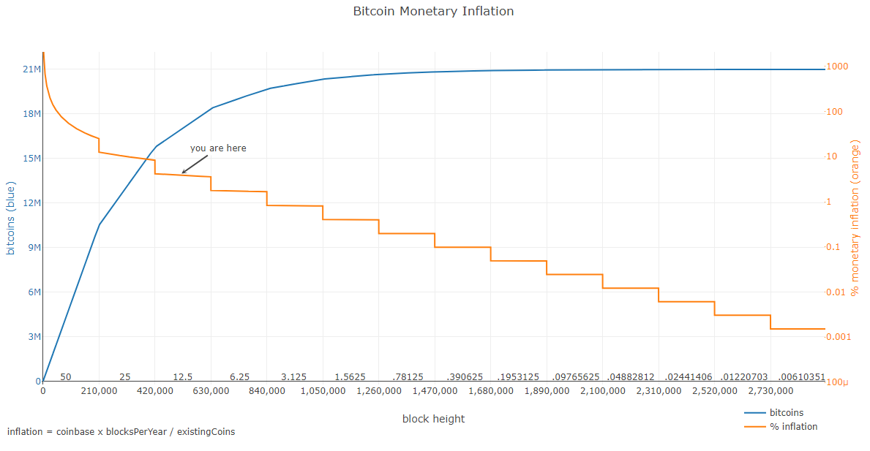
Bitcoin Monetary Policy

Slide 49
BTC monetary inflation
The blue line is the total number of bitcoins in circulation.
The orange line that drops is the inflation (how prices increase in a certain currency).
Inflation = coinbase*Blocks per Year/existing coins
Coinebase= how much money is being released(50,25,12.5,….).
For BTC, there is deflation, that's because more supply is limited and less blocks have been released into the system.
So Bitcoin is a deflationary type of currency.

Slide 50
The number of BTCs will not keep increasing forever it will converge to a certain amount, because there is a limitation in the accuracy of how much you can divide a single bitcoin.
So theoretically it could keep halving until infinity but because there is a certain number of decimal points after the comma it will stop at some point.
The final block and the final bitcoin that will be released as a block reward will happen in 2140 and the total number of bitcoins in circulation ever will be 21 million.

Slide 51
Transactions Fees are Meant to Replace Block Rewards
If miners are getting less and less reward by time; then after some time if it gets below one BTC per Block, what's the point of mining? Will the whole system collapse?
Well, its not expected to collapse because the fees should increase.
As time passes more and more people will be using bitcoins and therefore more transactions will be required to be processed and therefore miners will be getting more fees.
People will be paying higher fees for their transactions to go through because there will be more demand for transactions to go through.
There's a limit on how much transactions can go through and it will be a competitive market.
So if you want a transaction to go through you'll pay more fees and therefore the fees will go up and miners will be compensated.

Slide 52
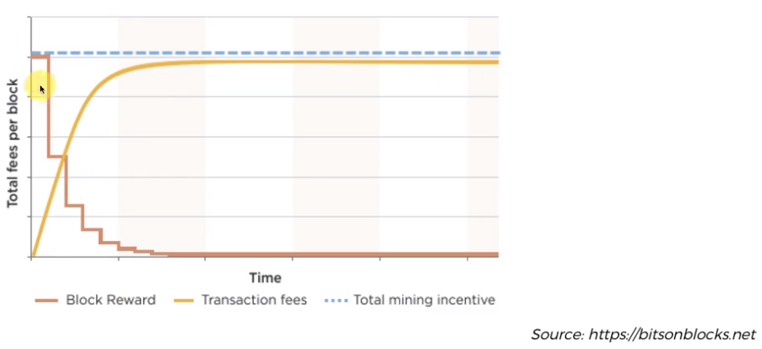

Slide 53
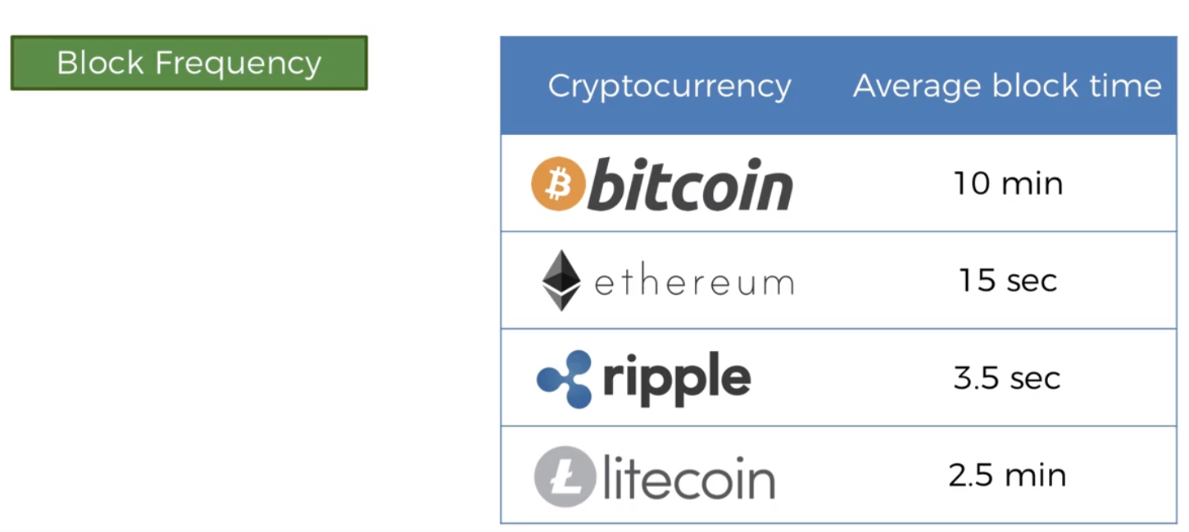
Bitcoin Monetary Policy
How often do these blocks come in?
Right now the reward is 12.5 BTC, so How often do they come in?
It depends on the cryptocurrency.
So it depends on the design of the system.

Slide 54
Common Misconceptions
Bitcoin is Anonymous
Bitcoin is used to launder money
Blockchain is a better Database
Blockchain is Bitcoin
You need to buy a full bitcoin

Slide 55
The first misconception you'll hear is that Bitcoin is anonymous.
Bitcoin is actually what's known as pseudonymous because when you're in the bitcoin network your bitcoin address is your identity, Bitcoin blockchain is open, every transaction done on the Bitcoin network keeps a permanent record on the public open blockchain.
So whenever you move money around with your bitcoin address, the rest of the world can see it and it's a permanent record.
It's very similar to a stage name for an artist. When an artist has a stage name people don't know his real name. But if at some point they find out their real name, there will be no cover anymore.

Slide 56
It's the same thing with Bitcoin, when you have a bitcoin address, nobody needs to know your name but at anytime you come in contact with the real world say for example you're going to exchange Bitcoins for currency, the exchange employee needs t verify the customer identity in order to give you regular fiat currency.
So at that point your bitcoin address gets matched with your real identity and you are no longer anonymous, you are actually Pseudonymous.

